Slide 1

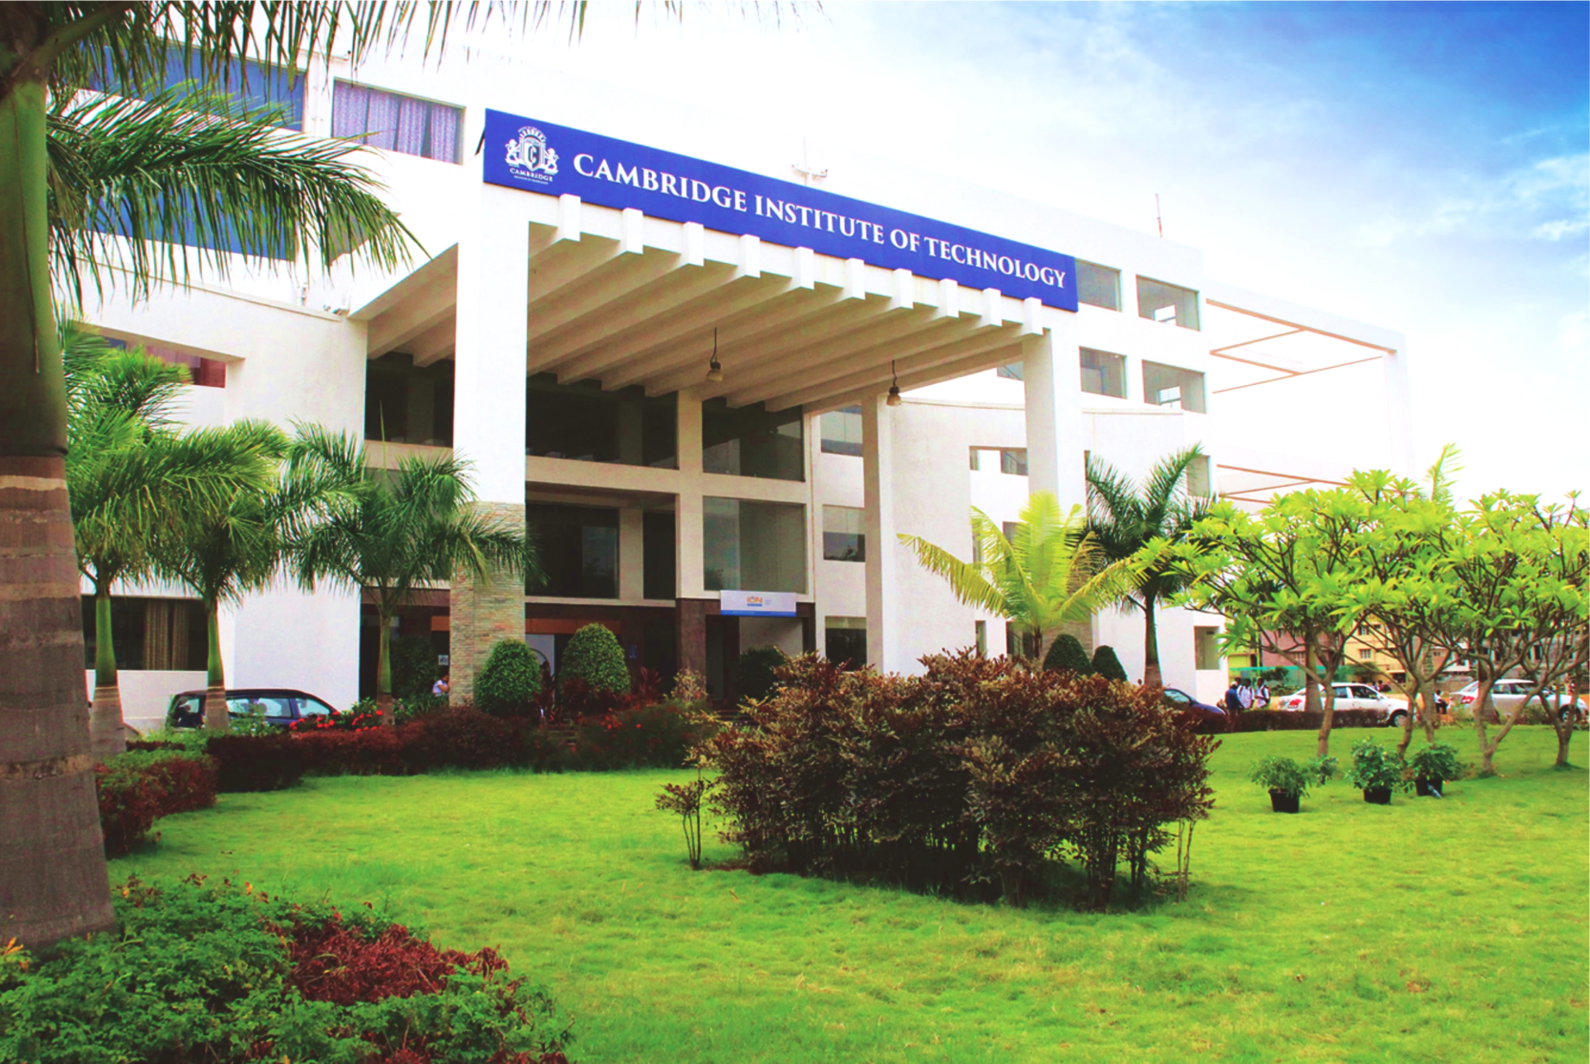
www.cambridge.edu.in
Mini Project Work
Subject Code: 21AIMP67
Project Name:
Question and Answer Generator
Presented By :
BHOPAL P 1CD21AI007
VARSHINI M A 1CD21AI058
Department of Artificial Intelligence and Machine Learning

Slide 2
Abstract
This FastAPI application allows users to upload PDF files, process the content to generate coding practice questions and answers, and then produce a PDF document with these Q&A pairs. The app integrates OpenAI's GPT-3.5-turbo for generating questions and answers, using LangChain for text processing and vector storage. It includes functionality for uploading files, analyzing content, and returning the output in a downloadable format. The app also serves static files and uses Jinja2 templates for rendering HTML pages. It is designed to help coders and programmers prepare for exams and coding tests by providing relevant practice material.
Department of Artificial Intelligence and Machine Learning www.cambridge.edu.in

Slide 3
Introduction
This FastAPI application facilitates the automated generation of practice questions and answers from PDF documents. The app mounts static files and templates directories to serve web pages and handle file uploads. Upon receiving a PDF file, the application reads its content, splits it into manageable chunks, and processes it using OpenAI's GPT-3.5-turbo model to generate relevant coding questions.
These questions are refined and answered using a retrieval-based question-answering chain. The results are compiled into a new PDF document, which is stored in the output directory and returned to the user.
The app is designed to support coders and programmers in their exam preparations by generating tailored practice materials from existing documentation.
Department of Artificial Intelligence and Machine Learning www.cambridge.edu.in

Slide 4
Problem Statement
“To develop a web application using FastAPI that allows users to upload PDF documents containing coding materials, automatically generates practice questions and answers from the content, and provides the resulting Q&A as a downloadable PDF”.
Department of Artificial Intelligence and Machine Learning www.cambridge.edu.in

Slide 5
Objectives
Serve Static Files and Templates:
Mount a directory for static files (/static) and set up Jinja2 templates for rendering HTML pages.
Set the OpenAI API key for accessing OpenAI services.
PDF Processing Utilities:
Define utility functions to count PDF pages and process PDF files using the PyPDFLoader and other components from LangChain.
Language Model Pipeline:
Implement a pipeline that processes PDF content to generate questions and answers using OpenAI's language model and LangChain's text splitting, embedding, and retrieval functionalities.
Generate PDF with Q&A:
Generate a new PDF containing questions and answers derived from the input PDF, and save it in a specified output directory.
Department of Artificial Intelligence and Machine Learning www.cambridge.edu.in

Slide 6
Literature Survey
SL NO | JOURNAL NAME | TITLE | DESCRIPTION | PROS | CONS
1 | Brown, T., Mann, B., Ryder, N., et al. (2020). | Language Models are Few-shot Learners.arXiv preprint arXiv. | This paper introduces GPT-3, detailing its architecture, capabilities, and performance across various NLP tasks. | State-of-the-Art PerformanceFew-Shot, One-Shot, and Zero-Shot LearningScalabilityGenerative Capabilities. | Bias and Ethical ConcernsLack of ExplainabilityData Privacy.
2 | Du, X., Shao, J., & Cardie, C. (2017). | Learning to Ask: Neural Question Generation for Reading Comprehension. ACL. | This paper explores methods for generating questions from textual content using neural networks, providing foundational techniques relevant to this project. | Innovative ApproachEncoder-Decoder FrameworkEmpirical EvaluationData Augmentation. | Dependence on Large DatasetsQuality of Generated QuestionsComplexity of Implementation.
Department of Artificial Intelligence and Machine Learning www.cambridge.edu.in

Slide 7
System Requirements Analysis
Software Requirements :
Operating System:
Linux (preferred), macOS, or Windows.
Python:
Python 3.7 or higher.
Python Packages:
fastapi
uvicorn
PyPDF2
openai (for OpenAI's GPT-3.5-turbo model)
Department of Artificial Intelligence and Machine Learning www.cambridge.edu.in

Slide 8
Hardware Requirements:
CPU:
A multi-core CPU is recommended for better performance. At least a quad-core processor.
RAM:
Minimum 8 GB of RAM.
Recommended 16 GB or higher for handling large PDF files and extensive processing.
Storage:
SSD storage for faster read/write operations, especially for handling large PDF files.
Internet Connection:
A stable internet connection is required to interact with the OpenAI API for generating questions and answers.
Artificial Intelligence and Machine Learning
Department of Artificial Intelligence and Machine Learning www.cambridge.edu.in

Slide 9
Methodology
Start
Upload PDF
Analyze PDF
Generate Q&A
Save In PDF
Download PDF
End
Department of Artificial Intelligence and Machine Learning www.cambridge.edu.in

Slide 10
System Architecture
Fast API Application
User Interface
Upload and analyze PDF
PDF processing
LLM Pipeline
PDF Generation
Store Output in PDF
Department of Artificial Intelligence and Machine Learning www.cambridge.edu.in

Slide 11
Tools and Technologies
FastAPI: A modern, fast (high-performance), web framework for building APIs with Python 3.7+ based on standard Python type hints.
Jinja2: A templating engine for Python, used here to render HTML templates.
aiofiles: An asynchronous file handling module.
PyPDF2: A PDF library to read and manipulate PDF files.
OpenAI GPT-3.5 (ChatOpenAI): Used for generating questions and answers based on the PDF content.
LangChain: A framework for developing applications powered by language models.
ReportLab: A powerful library for creating PDFs in Python.
uvicorn: A lightning-fast ASGI server implementation, used here to run the FastAPI application.
plants
s a Convolutional Neural Network (CNN) model trained on the to classify images and identify 15 common diseases in tomato, potato, and pepper plants
, and pepper pls
Department of Artificial Intelligence and Machine Learning www.cambridge.edu.in

Slide 12
Implementation
Imports and Initialization:
All necessary imports for FastAPI, LangChain, and PDF processing are included.
Environment variable for the OpenAI API key is set.
PDF Page Counting:
count_pdf_pages function to count pages in a PDF using PyPDF2.
PDF File Processing:
file_processing function to load and split the PDF content into smaller chunks for question and answer generation.
LLM Pipeline:
llm_pipeline function to handle the entire pipeline from question generation to answer generation using OpenAI's GPT-3.5-turbo.
Embeddings and vector store setup using FAISS for answer retrieval.
PDF Generation:
get_pdf function to generate a new PDF with questions and answers, using ReportLab for document creation.
FastAPI Endpoints:
index: Renders the index.html template.
upload: Handles file uploads and saves the PDF to a specific directory.
analyze: Processes the uploaded PDF and generates a new PDF with questions and answers.
plants
s a Convolutional Neural Network (CNN) model trained on the to classify images and identify 15 common diseases in tomato, potato, and pepper plants
, and pepper pls
Department of Artificial Intelligence and Machine Learning www.cambridge.edu.in

Slide 13
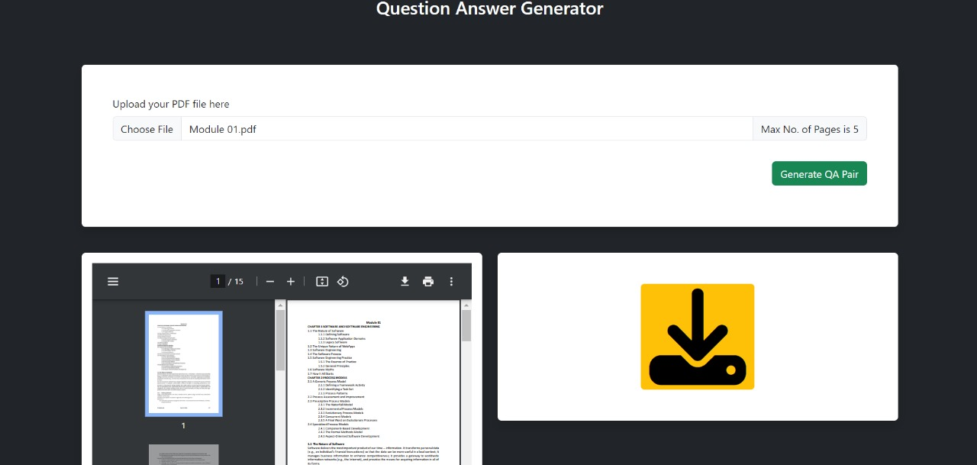
Output:
Department of Artificial Intelligence and Machine Learning www.cambridge.edu.in

Slide 14
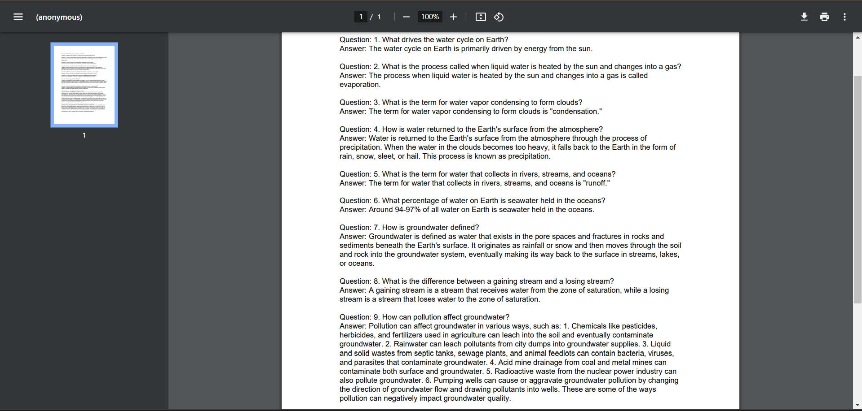
Result:
Department of Artificial Intelligence and Machine Learning www.cambridge.edu.in

Slide 15
Conclusion
This FastAPI application integrates various tools for processing PDFs, generating questions and answers, and serving these through a web interface. It demonstrates a practical use of modern NLP tools and FastAPI's capabilities for building a web-based application. Ensure the corrections and improvements are applied to enhance the functionality and security of the application. system that allows users to upload PDF documents, analyze their content to generate and refine questions, and produce a PDF report with these questions and their answers.
Department of Artificial Intelligence and Machine Learning www.cambridge.edu.in

Slide 16
Future Work
Improved PDF Layout and Formatting
User Authentication and Management
Multi-File Support
Enhanced NLP Capabilities
Integration with External Services
Enhanced User Interface
Department of Artificial Intelligence and Machine Learning www.cambridge.edu.in

Slide 17
References
[1] Neural Question Generation from Text: A Preliminary Study by Xinya Du, Junru Shao, and Claire Cardie.
[2] SQuAD: 100,000+ Questions for Machine Comprehension of Text by Pranav Rajpurkar, Jian Zhang, Konstantin Lopyrev, and Percy Liang.
[3] n open-source library that includes tools and models for building conversational systems, including question answering: DeepPavlov GitHub
[4] BERT: Pre-training of Deep Bidirectional Transformers for Language Understanding by Devlin et al. (2018).
[5] QA-GNN: Reasoning with Language Models and Knowledge Graphs for Question Answering by Yasunaga et al. (2021).
Department of Artificial Intelligence and Machine Learning www.cambridge.edu.in

Slide 18
THANK YOU
Department of Artificial Intelligence and Machine Learning www.cambridge.edu.in

